Slide 1
Data Mining and Visualization
-Rakshit Rathi

Slide 2
Data Description
The data used for the mining and visualization was related to Data Breaches at different organizations.
The attributes associated were the number of records lost during this data breach
The reason for this breach – (Hacked, Poor Security, etc.)
The source from where the news and details have come.
Links to these sources
The severity of the breach and few more other details.

Slide 3
Data Cleaning and Mining
As this was raw data, we had many discrepancies in the dataset
Initially pulled this data from the csv to Python’s Pandas Dataframes.
Tried to remove rows where he main attributes like Entity name, record counts were populated as NULL as they didn’t make any sense.
Tried to format the data by splitting a single column into multiple column and store it in a uniform format
Removed the duplicate records
Removed accent characters from attributes
Updated Null values for few columns to be either 0 or in the desired format

Slide 4
Data Cleaning and Mining
Used the subset of the original data by only considering the required columns.
Because of time constraints could not run few models which I was thinking to provide using other libraries like Pyspark.
Maintain a copy of the data for processing and analysis.

Slide 5
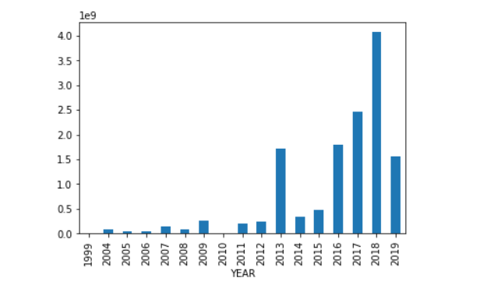
Data Visualizations
Used the MATPLOTLIB library for visualizations.
Created a bar graph for number records which got stolen in each year from the dataset.
Used plot.bar() function to map the records_lost column to year column by grouping the overall sum

Slide 6
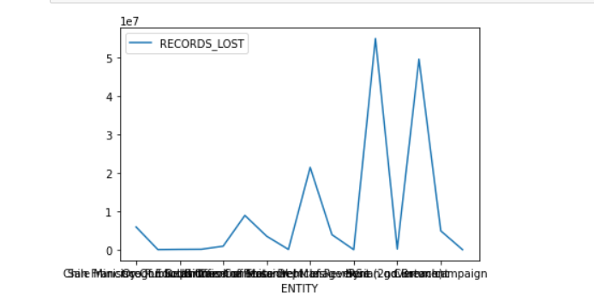
Data Visualizations
Second graph I mapped was to show the Government entities which got Hacked and what was the loss of data or how much data got breached which shows how poor the security at the government offices are.
I focused on government entity because that is a general public information and can cause a bigger impact on society if not secured properly.
Created a connected graph plotting names of the government entites on x-axis and number of records breached on Y-axis

Slide 7
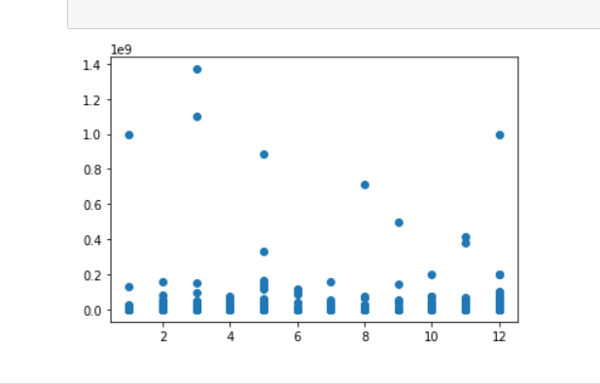
Data Visualizations
Third graph I created was to find any result to see if there is any specific relation to the month of the year where these data breaches occur often.
Firstly, split this Month information from the story attribute converted to numerical format to display in proper sequence
Plotted this again with the record lost or breached.
Created a scatter plot graph for this visualization.
Months

Slide 8
Future Scope
Using Pyspark ML libraries to map these dataset to form a cluster and provide better results which can help to find more vulnerable companies.
Use Tableau to provide more better visualizations with better scenarios to understand the data more thoroughly
Use different mapping techniques to provide better algorithm searches.

Slide 9
Thank you!

